Slide 1
Learning-based Long-range Axon Tracing in Dense Scenes
Mark Hernandez1, Adam Brewster1, Larry Thul1, Brian A. Telfer1, Arjun Majumdar1, Heejin Choi2, Taeyun Ku2, Kwanghun Chung2, and Laura J. Brattain1
2018 IEEE 15th International Symposium on Biomedical Imaging (ISBI 2018) April 4-7, 2018, Washington, D.C., USA
王鹏
2018-12-12

Slide 2
1. Abstract

Slide 3
We developed a machine learning-based high performance computing pipeline:
a convolutional neural network detects axon fiber voxels
morphological operations extract fiber centerlines
tracking logic connects fiber segments across low-intensity gaps and unresolved fiber crossings

Slide 4
2. Method

Slide 5
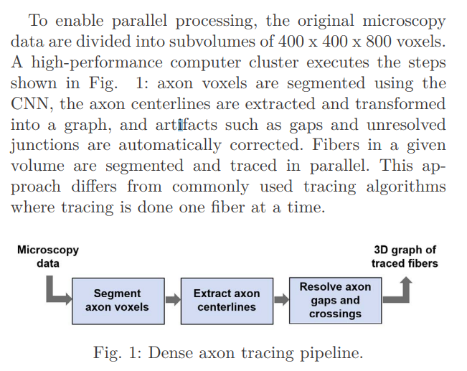

Slide 6
2.1 Axon Voxel Segmentation
Training data for the network consist of 19 × 19 × 19 voxel volumes which are labeled as either background (0) or axons (1).
Following an active learning approach the model was trained in the background while the user selected misclassified voxels, which were added to the training set.
We then found the longest detected fibers, performed manual reviews, and built a much larger training set (approx. 10,000 for each class) by choosing points on the centerline of a long fiber as positive cases and points that were near but not on the centerline as negative cases

Slide 7
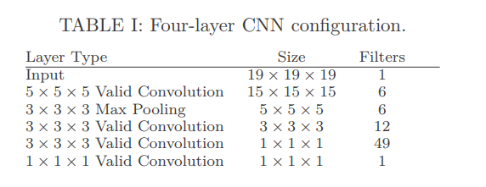

Slide 8
2.2 Centerline Extraction
A homotopic thinning algorithm is applied to the binary CNN output of each subvolume to produce a 3D medial axis skeleton that estimates the locations of the axon fiber centerlines
To avoid boundary issues caused by partitioning, the subvolumes are padded in all directions by 32 voxels.

Slide 9
2.3 Resolving Artifacts
There are three types of artifacts in the graphs:
Intra-subvolume gaps that fragment a fiber within a subvolume
inter-subvolume gaps in fibers traversing subvolume boundaries
false junctions where two or more crossing fibers are erroneously connected

Slide 10
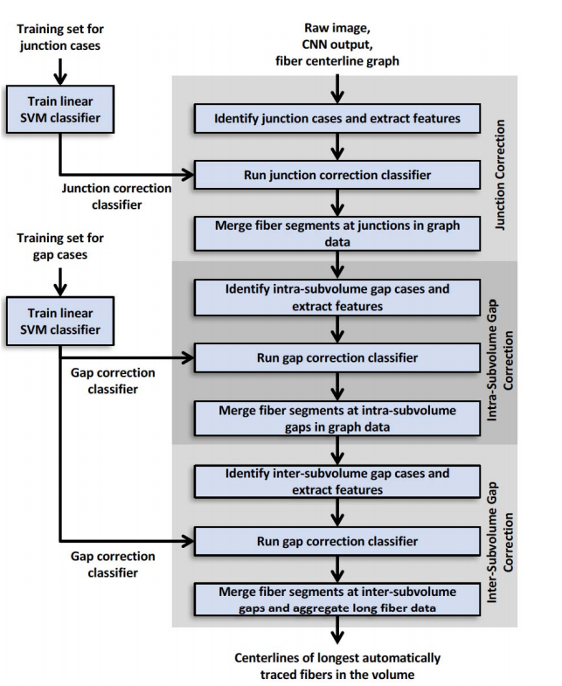
手工矫正太费时，所以训练学习器来矫正

Slide 11
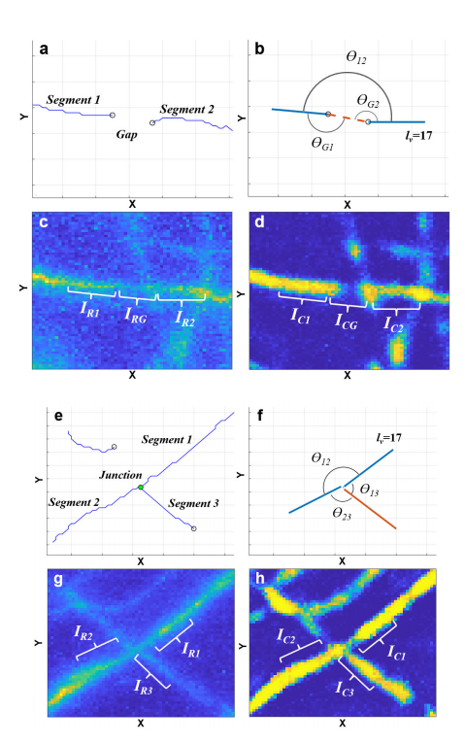
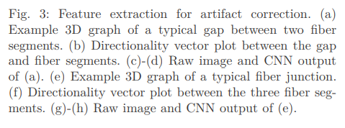

Slide 12
2.3.1 Identification of Potential Artifacts
To identify intra-subvolume gap candidates, pairs of neighboring end nodes within 20 voxels of each other are located. If an end node has more than one neighbor, the most likely fiber segment pair to merge is chosen based on greatest co-linearity
To identify inter-subvolume gap candidates, only end nodes within 10 voxels of a subvolume boundary are considered. End nodes from the adjacent subvolume’s boundary are found that are within 20 voxels of the reference end node. Candidate segments to merge are chosen based on greatest co-linearity.

Slide 13
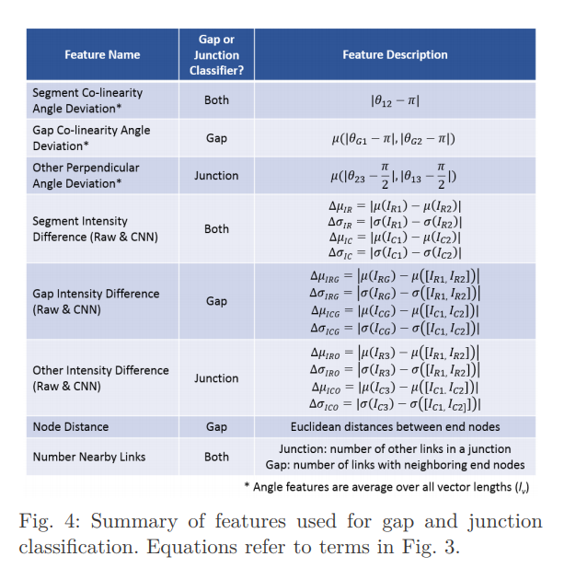
2.3.2 Feature Extraction

Slide 14
2.3.3 Classifiers
Two binary classifiers are used to identify which potential artifacts should be corrected.
The first classifier is trained using 200 junction candidates with labels indicating the valid junction corrections
The second is trained with a mix of 290 intra- and inter-subvolume gap candidates labeled with valid gap corrections

Slide 15
3. Results

Slide 16
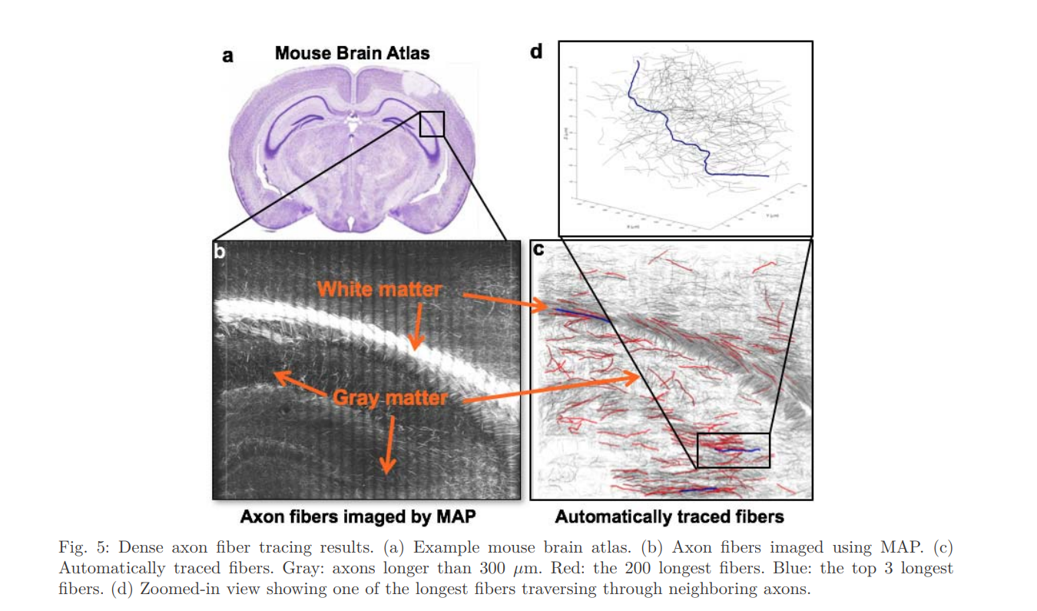

Slide 17
